Slide 1
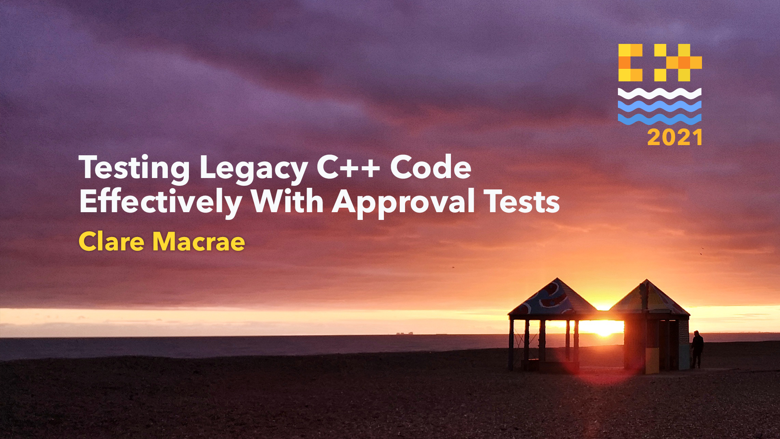

Slide 2
Testing Legacy Code Effectively with Approval Tests
Workshop
@ClareMacraeUK – Trainer @LlewellynFalco – co-creator
Notes:
Hello and welcome

Slide 3
Contents
Introduction
Mobbing Intro
Testing “functional” code
Testing with Approvals
Techniques for testing hard code
Techniques for improving hard code
Notes:
Video and Audio on the whole time
Mute: Command + Shift + A to toggle
Unmute temporarily by holding the space bar
If that doesn’t work, check your settings
Scream for 30 seconds – toggle mute on and off
Grid view:
By default Zoom only shows the speaker
We want you to see everyone at the same time
So toggle on the Grid view
Video:
Keep on
If you need to leave, mute audio and video
And we will assume you have stepped out of the room, to take care of stuff
This is our protocol

Slide 4
ZOOM
Mute – Grid View – Video
Notes:
Video and Audio on the whole time
Mute: Command + Shift + A to toggle
Unmute temporarily by holding the space bar
If that doesn’t work, check your settings
Scream for 30 seconds – toggle mute on and off
Grid view:
By default Zoom only shows the speaker
We want you to see everyone at the same time
So toggle on the Grid view
Video:
Keep on
If you need to leave, mute audio and video
And we will assume you have stepped out of the room, to take care of stuff
This is our protocol

Slide 5
DISCORD
Class Notes – Questions – Useful Links
Notes:
We will also be using the workshop channel Discord for shared notes
Advantage over chat: persistent, rearrangeable

Slide 6
Tell me and I forget,
teach me and I may remember,
involve me and I learn.
- Xun Kuang (312-230 BC)
Notes:
Let’s talk about the philosophy of the course, and how we teach
There are different things we try to teach
We really concerned that what you use this week, you will use it, and it will make your life better
Less lecturing, more doing
We think of it as….

Slide 7
Awareness (show) Proficiency (do) Fluency (repeat)
Notes:
Awareness
Things to be aware of – things we will show you
Not good enough
Proficiency
Things we want you to be able to do: You have to do it, lots of lab work
Fluency
Sometimes it’s not enough to be able to do something, you need to do it without conscious thought
The only way to build this is through repetition
We need you to be able to do these things well, whilst focus is on something else

Slide 8
0 -> 1
Notes:
Last thing: concept of zero to one
In almost all things, the first time you do it takes as long as the next 10 times
You’ll see we will do something and then repeat it a bunch of times. That repetition will take a lot less time.
Our first things will be small steps, to handle the 0 to 1 problem.

Slide 9
EC2 SERVER
AnyDesk – MobTime - Workshop
Notes:
We are going to be doing all this work in labs on an EC2 server
Let’s all log on to the server
Open the Google Doc
AnyDesk to server – log in info is in Discord

